Slide 1
Priority
Category Partitioning Testing Tool
Final Presentation
FINAL
PRESENTATION
Team 4
201311265 김상원 201311269 김제헌 201311297 이상명 201210194 김정환

Slide 2
Team4 Presentation Index
Final Presentation
1. Stage Review | Stage 1000 Review
 | Stage 2030 Review
 | Stage 2040 Review
 | Stage 2050 & 2060 Review
2. Feedback | T1 feedback
 | T2 feedback
3. Epilogue
4. Demonstration

Slide 3
Stage Review
Stage 1000
Review
Stage Review Stage 1000 Review

Slide 4
Activity 1003. Define Requirements 중 Functional Requirements
Stage Review Stage 1000 Review

Slide 5
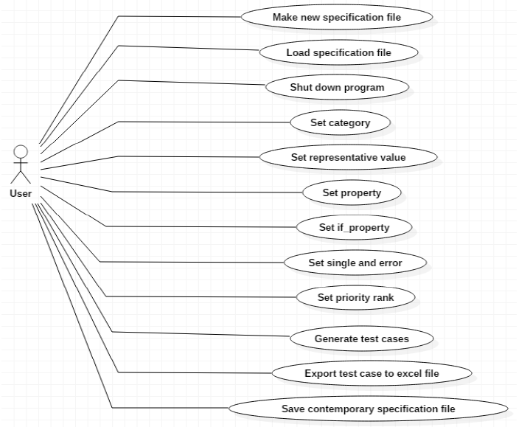
Activity 1007. Define Business Use Case 중 Draw a Use Case Diagram
Stage Review Stage 1000 Review

Slide 6
Stage Review
Stage 2030
Review
Stage Review Stage 2030 Review

Slide 7
Activity 2031. Define Essential Use Case 중 일부
Stage Review Stage 2030 Review

Slide 8
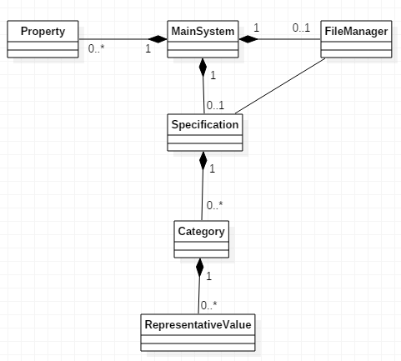
Activity 2033. Define Domain Model
Stage Review Stage 2030 Review

Slide 9
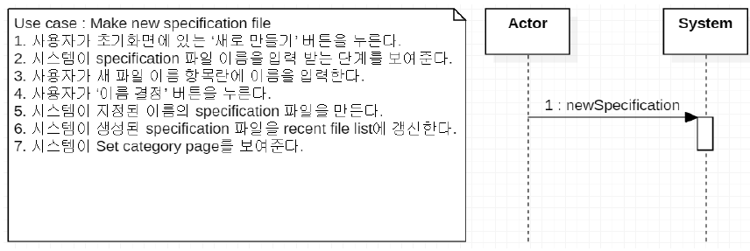
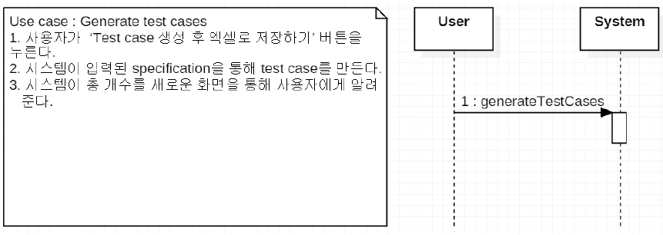
Activity 2035. Define System Sequence Diagrams 중 일부
Stage Review Stage 2030 Review

Slide 10
Stage Review
Stage 2040
Review
Stage Review Stage 2040 Review

Slide 11
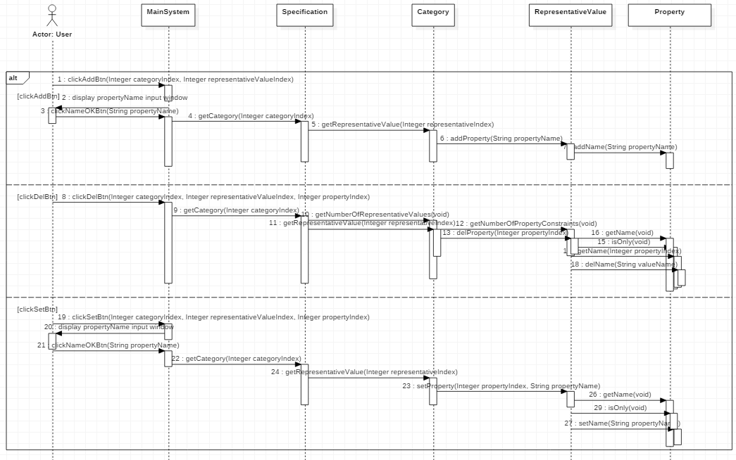
Activity 2044. Define Interaction Diagrams 중 일부
Stage Review Stage 2040 Review
[setProperty]

Slide 12
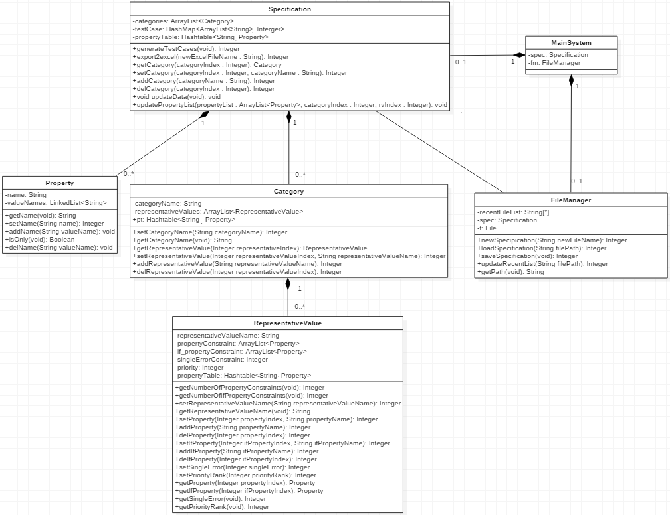
Activity 2045. Define Design Class Diagrams
Stage Review Stage 2040 Review

Slide 13
Stage Review
Stage 2050 & 2060
Review
Stage Review Stage 2050 & 2060 Review

Slide 14
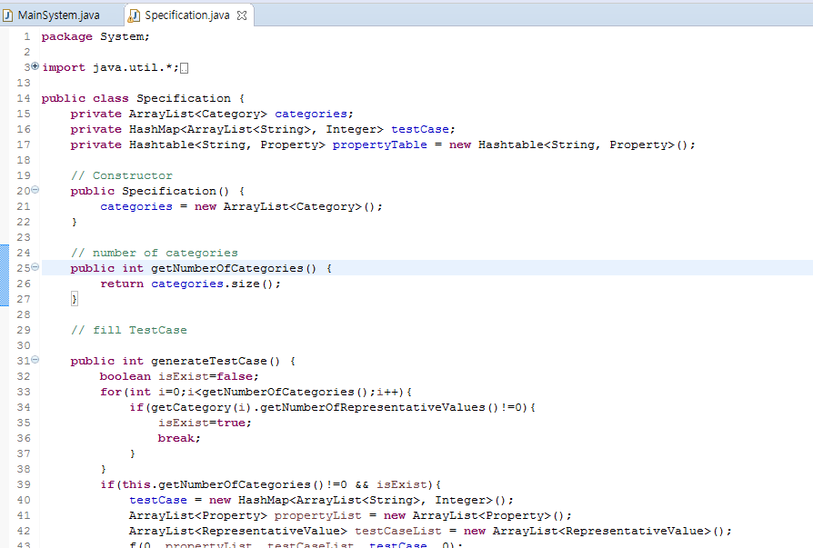
Stage 2050. Implementation
Stage Review Stage 2050 & 2060 Review

Slide 15
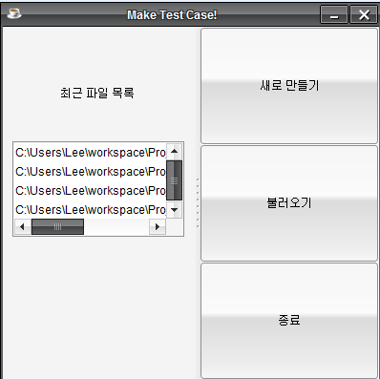
Stage 2050. Implementation
Stage Review Stage 2050 & 2060 Review

Slide 16
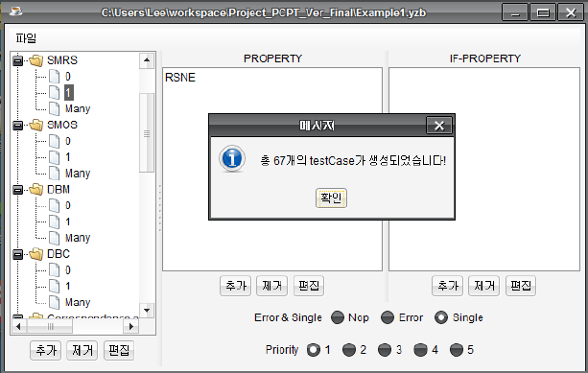
Stage 2050. Implementation
Stage Review Stage 2050 & 2060 Review

Slide 17
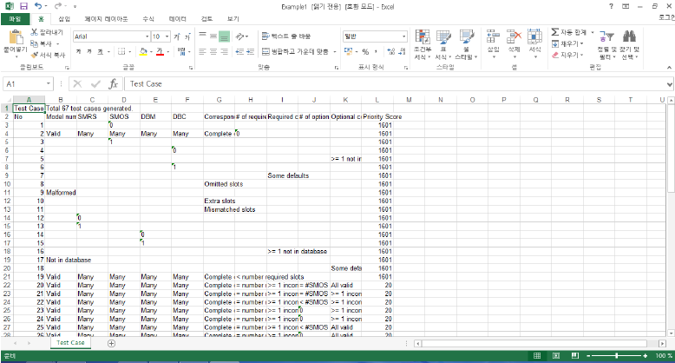
Stage 2050. Implementation
Stage Review Stage 2050 & 2060 Review

Slide 18
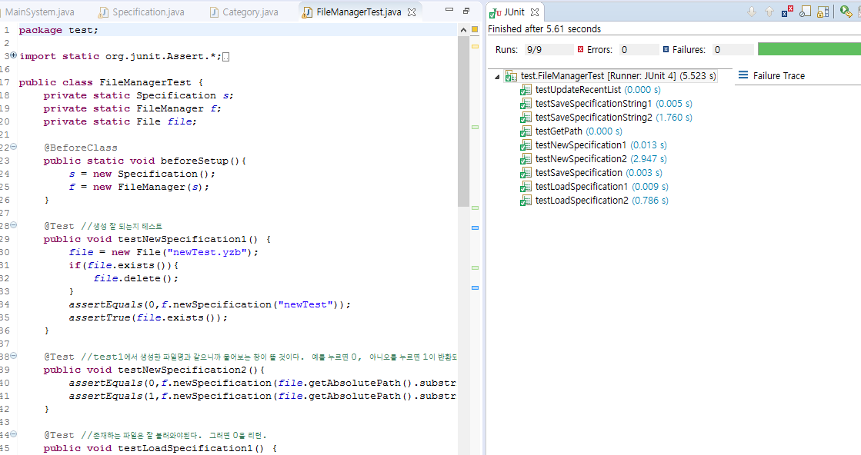
Activity 2061. Unit Testing
Stage Review Stage 2050 & 2060 Review

Slide 19
Team 1
Feedback
Team1 Feedback

Slide 20
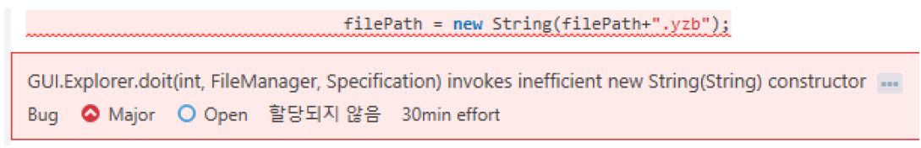
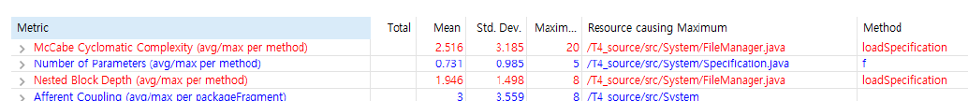
T1’s Analysis
Team1 Feedback
[Sonar Qube]
[Metrics]

Slide 21
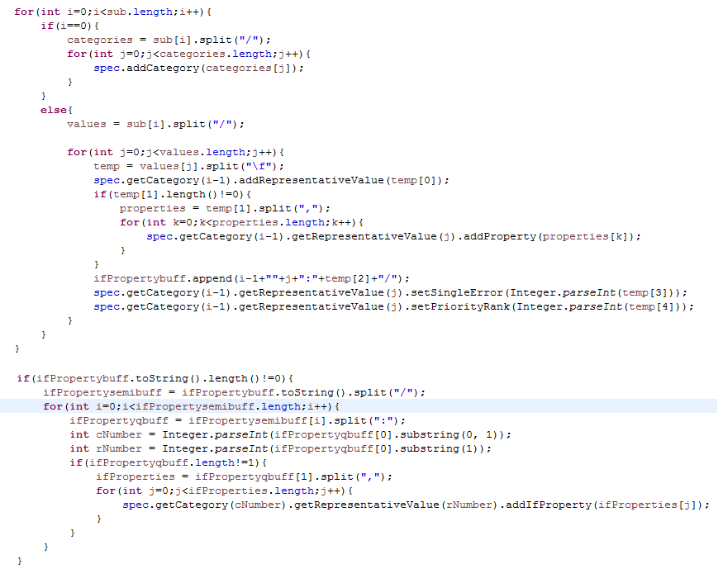
T1’s Analysis
Team1 Feedback
[T4의 코드 중 일부]

Slide 22
Team 2
Feedback
Team2 Feedback

Slide 23
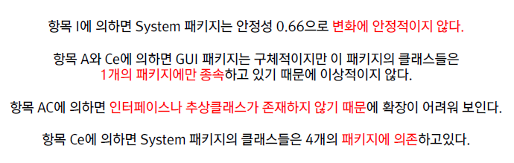
T2’s Analysis
Team2 Feedback
[JDepend]

Slide 24


T2’s Analysis
Team2 Feedback
[FindBug]
[CheckStyle]

Slide 25
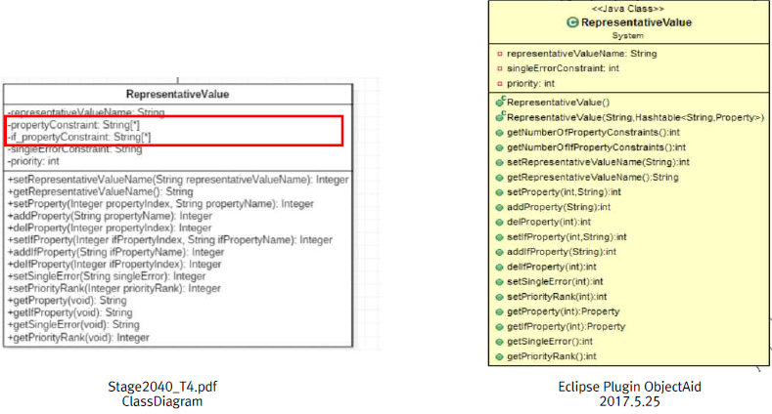
T2’s Analysis
Team2 Feedback
[ETC]

Slide 26
T4
Epilogue
T4 Epilogue

Slide 27
T4
Demonstration
T4 Demonstration

Slide 28
Final Presentation
Q & A

Slide 29
Final Presentation
Thank you!

